Slide 1


We would like to welcome you all
Click to add tex

Slide 2
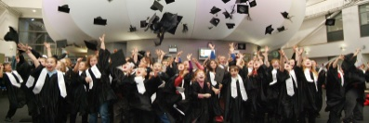
What is Children’s University?
Children's University rewards for you for taking part in extra-curricular learning activities.
It is an exciting way for you to learn whilst having fun and doing things they enjoy!
At Children’s University, we celebrate achievement and reward you for taking part in activities with our certificates and graduation ceremonies!

Slide 3
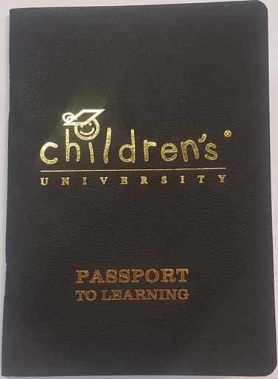
Passport to Learning
Your teachers will be giving you a Passport to Learning, which looks like this one over here
It is for you to record all of the hours of activity that you take part in.
It is IMPORTANT that you remember your passport when you go so when we check your passports we can give you your Children’s University Certificates when you have done enough hours!
Learning doesn't just take place in the classroom. Children learn new things in all sorts of places: at museums, on nature walks, by playing sports and music, and much more.

Slide 4
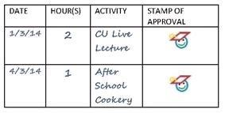
How do I record hours in my Passport?
You must take your Passport to Learning with you to each Learning Destination that you attend.
The activity leader will fill in your Passport to Learning (with either a stamp or a signature) to show you have taken part. If it’s somewhere like the Wildlife Park or CAST then a member of staff will sign it when you buy a ticket.

Slide 5


Where can I use my ‘Passport to Learning?
You can collect your hours at any activities or clubs you do at school and you can also collect hours for clubs you go to outside of school, and lots of other fun places too!
If it is outside of school, it must be what we call a ‘Learning Destination’. These are places places that our team at Children’s University have checked with and made sure that they offer extra-curricular learning opportunities for children.
Most CU Learning Destinations display our Learning Destination sticker or poster, like this:

Slide 6
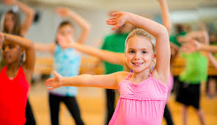




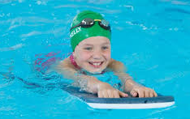


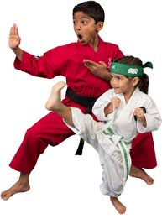


Types of Learning Destinations

Slide 7
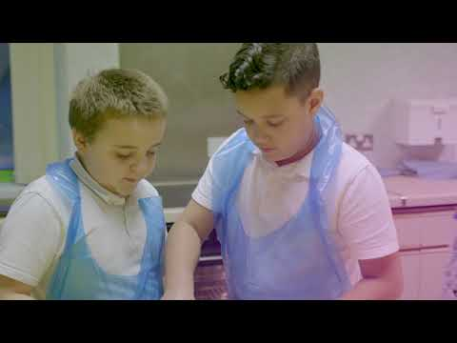
Children's University
We have over 110,000 children who are part of Children's University, over 7000 of those children are from Doncaster.

Slide 8
How can my club become a
Learning Destination?
Becoming a Learning Destination is absolutely FREE!
If you go somewhere you think would make a great Learning Destination then ask your teacher to let us know!
We can contact the club/organisation to find out some information about what activities they provide.

Slide 9
Certificates
You will get you first BRONZE certificate when you have collected 30 hours in your Passport to Learning
The next one will be a SILVER certificate for 65 hours and then a GOLD certificate for 100 hours
You will then get certificates at every stage of 30, 65 and 100 hours after that, all the way up to 1,000 hours!

Slide 10
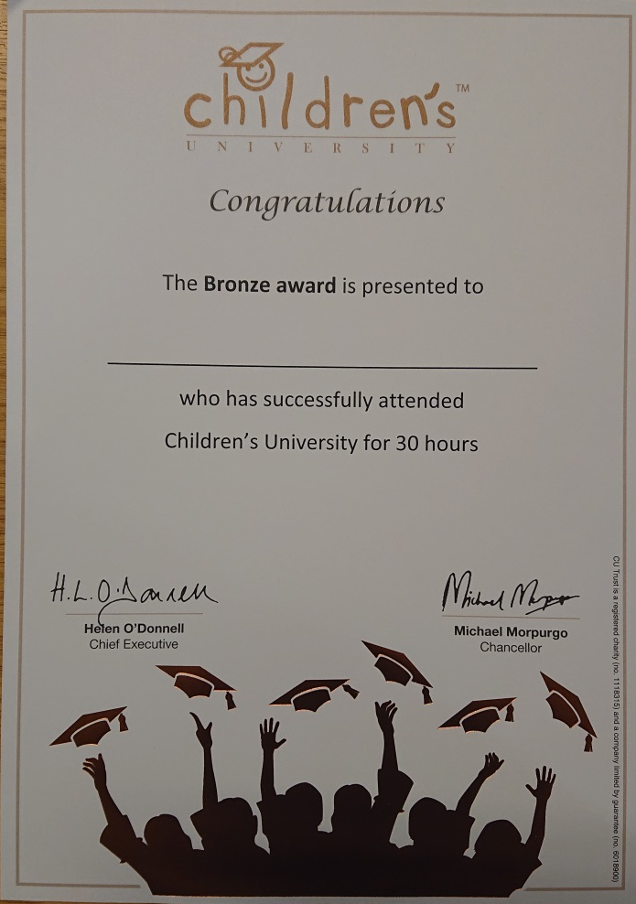
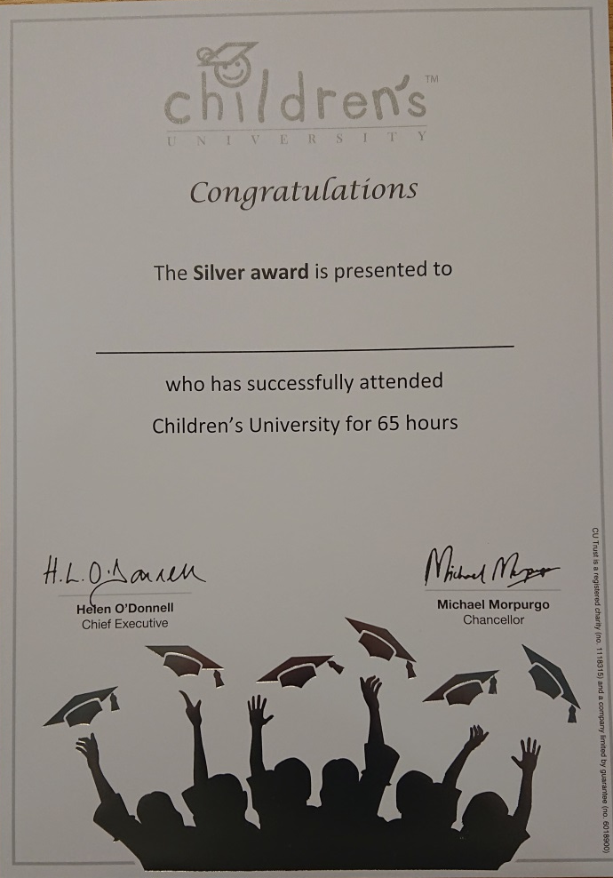
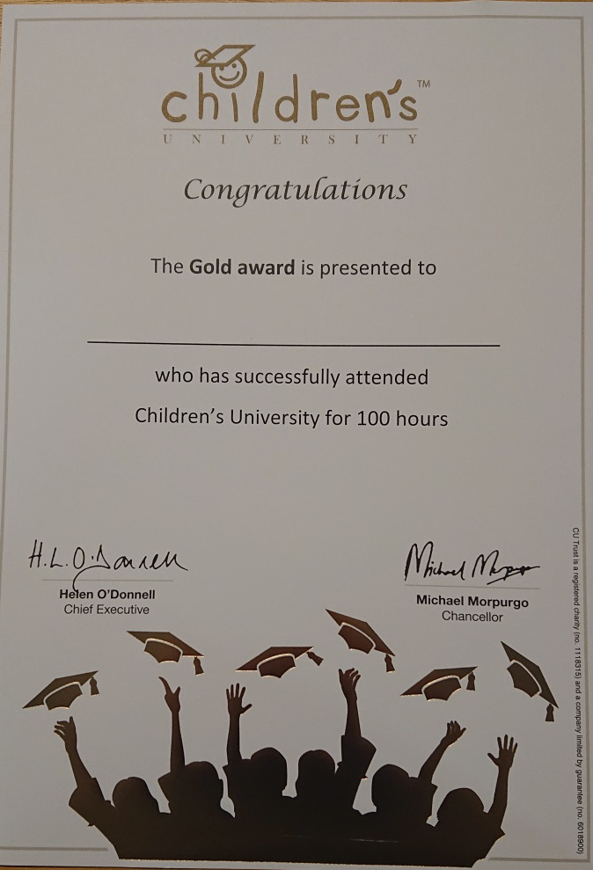
Certificates look like this…

Slide 11

Graduation!
You only need to collect 30 hours in your passport to be invited to our Children’s University Graduation!

